Slide 1
Timeseries I
10.9.24

Slide 2
Learning Objectives
Convolution
Convolution
Convolution
Convolution
How to analyze time-series (convolution)

Slide 3
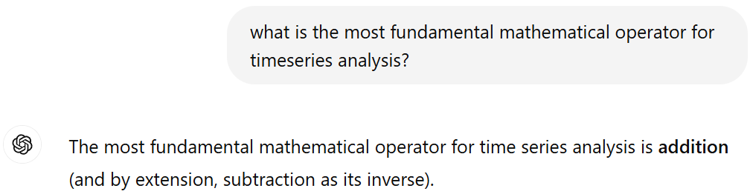
Is convolution important?

Slide 4
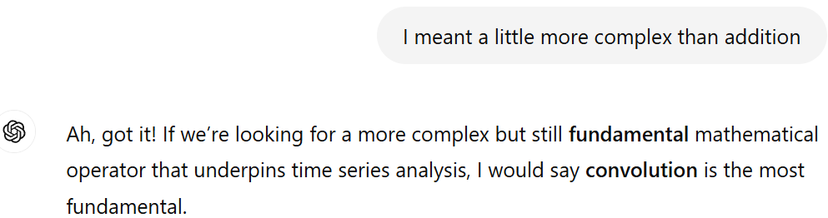
Is convolution important?

Slide 5
In the broadest sense:
Convolution involves applying an operation over moving windows to generate a new series
1 4 3 2 1 0 2
1 4 3 2 1 0 2
1 4 3 2 1 0 2
1 4 3 2 1 0 2

Slide 6

Using moving sum as an example
Convolution involves applying an operation over moving windows to generate a new series
1 4 3 2 1 0 2
8
$$Σ$$
1 4 3 2 1 0 2
9
1 4 3 2 1 0 2
6
1 4 3 2 1 0 2
3

Slide 7
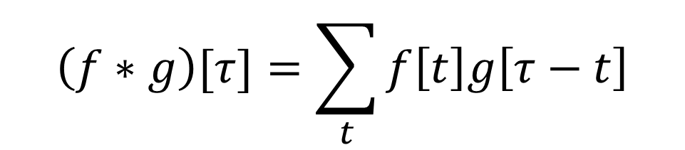


Definition of Convolution
A weighted moving sum.
Kernel (g): array of weights (can be n-dim)
$$\left(f∗g\right)[τ]=\sum_{t}{f\left[t\right]g\left[τ−t\right]}$$
$$f:$$
[A B C D E]
$$g:$$
[1 3]
For 3-step moving-sum:
g=[….0,0,1,1,1,0,0…]

Slide 8



Example 1
$$f:$$
[A B C D E]
$$g:$$
[1 3]
Step 1: flip $g$
Step 2: moving sum
[A B C D E]
3A+B
3 1
[A B C D E]
3B+C
3 1
[A B C D E]
3C+D
3 1
[A B C D E]
3D+E
3 1

Slide 9

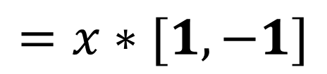

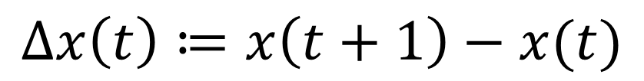


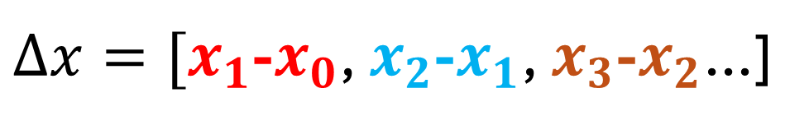


Example 2: Finite-Differences
Suppose I want the finite-difference/derivative timeseries:
$$x\left(0\right) x\left(1\right) x\left(2\right) x\left(3\right)…$$
$$Δx\left(t\right)≔x\left(t+1\right)−x(t)$$
$$[−1 1]$$
$$=x∗[1,−1]$$
$$x\left(0\right) x\left(1\right) x\left(2\right) x\left(3\right)…$$
$$[−1 1]$$
$$x\left(0\right) x\left(1\right) x\left(2\right) x\left(3\right)…$$
$$[−1 1]$$
$Δx=[x_{1}$-$x_{0}$, $x_{2}$-$x_{1}$, $x_{3}$-$x_{2}$…]

Slide 10
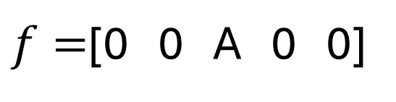
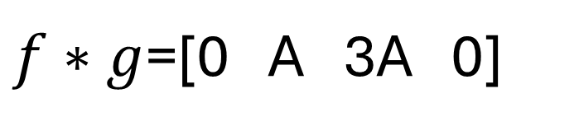
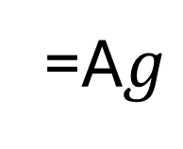
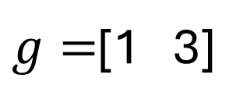
The point-spread perspective
An alternative view for finite-length kernels
Start with a sparse timeseries
0 0 A 0 0
$f=$[0 0 A 0 0]
3 1
$g=$[1 3]
0 0 A 0 0
3 1
$f∗g$=[0 A 3A 0]
0 0 A 0 0
=A$g$
3 1
0 0 A 0 0
3 1

Slide 11
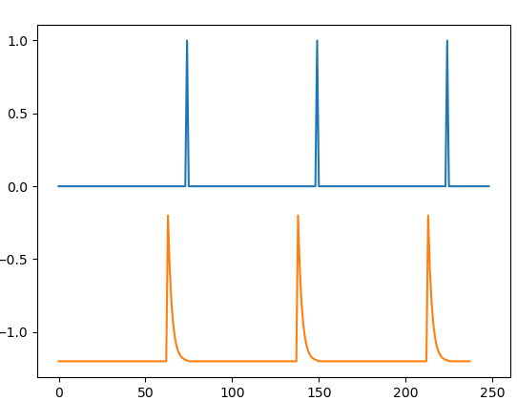
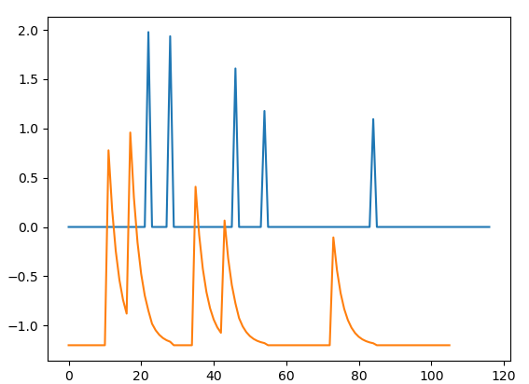
Point spread as Spike-Responses
np.convolve(data, kernel, 'valid')

Slide 12





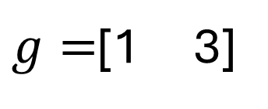



The point-spread perspective
An alternative view for “finite-length” kernels
$$f=$$
[0 A B C D 0]
$g=$[1 3]
$$f∗g=$$
[0 A 0 0 0 0]
[A 3A 0 0 0 ]
$$+$$
[0 0 B 0 0 0]
$$+$$
[0 B 3B 0 0 ]
$$+$$
[0 0 0 C 0 0]
$$+$$
[0 0 C 3C 0 ]
$$+$$
[0 0 0 0 D 0]
$$+$$
[0 0 0 D 3D]
$$f∗g=$$
[A 3A+B 3B+C 3C+D 3D]

Slide 13
Things to do with Kernels
Smoothing
Interpolating
Denoising
Filtering
Feature extraction

Slide 14
Demo: 2 ways to use convolution
Change-point detection
Moving variance estimator
Onto Jupyter for the remainder….

Slide 15
fin

